Slide 1

London’s
Labour Market Information
Why is this important to you?

Slide 2
What is Labour Market Information (LMI)?
Labour Market Information (LMI) describes all kinds of information used to make labour market decisions.
LMI can be a compilation of detailed statistical data on jobs and salaries, employers and employees, sectors, current employment conditions and future trends.
It may also include other kinds of information that inform labour market decisions, such as emerging technologies, the workplace environment, working conditions and the cost of living.
https://www.youtube.com/watch?v=xmuFBlhLZqk

Slide 3
Why was Logic School set up?
Logic was set up to provide a link between Education and Employment.
Employers complain that students do not have the right employability skills to be successful in employment.
When setting up Logic, we looked at what was going to most benefit students in the local area in terms of employment opportunities?
As a result, we decided to specialise in Business, Finance, Computing and Creative Media? WHY?

Slide 4
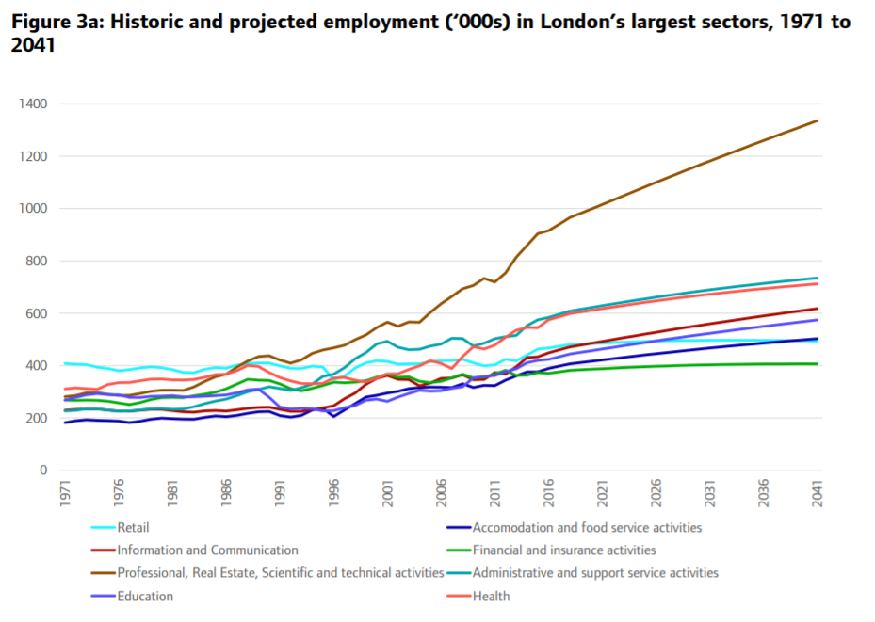
Why was Logic School set up?
Basically, the biggest growth from now to 2041 will be in:
Professional, Real estate, Science and Technical services
Information and Communication

Slide 5
London LMI - Key Jobs now
These sectors employ more than 60% of workers in London:
Professional - Head Offices and Management Consultants; Legal, Finance and Accounting activities; Marketing and Advertising; Business Administration
Technical - Architectural and Engineering activities; Information and Communication; Construction
Scientific - which includes: Research and Experimental activities, Technological research.
There are also significant opportunities in other key sectors for London including:
Retail
Healthcare
Education
Hotels, Events and Food
Logistics, Transport and Storage
Leisure, Arts and Entertainment

Slide 6
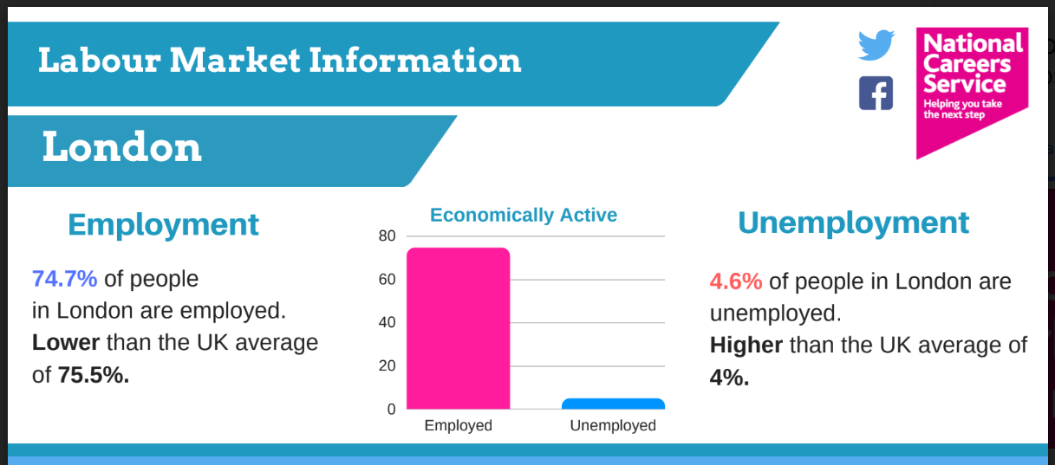
Current London LMI.

Slide 7
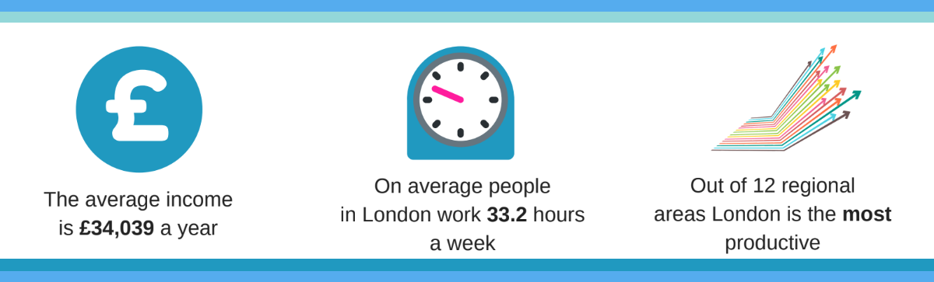
Current London LMI.

Slide 8
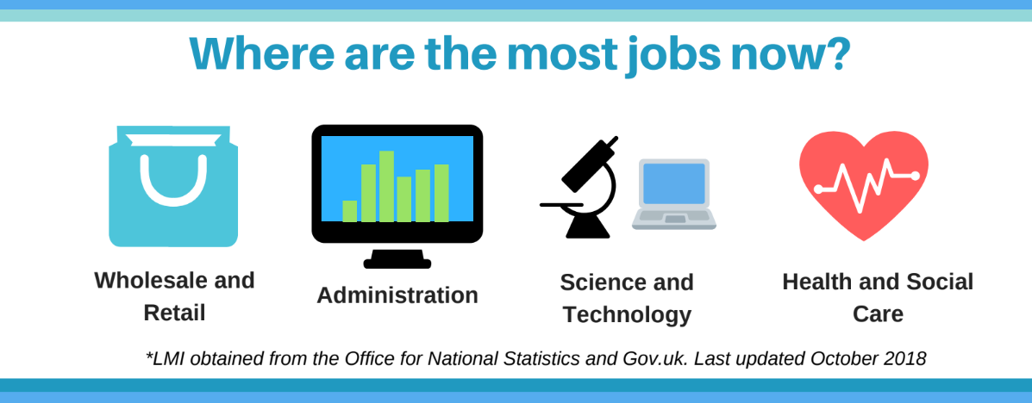
Current London LMI.

Slide 9
Key UK Data for your age bracket - 16-24
The UK Unemployment rate in June 2018 was 4.2%.
The unemployment rate for 16-24 year olds was 11.9%, down from 12.5% a year ago.
520,000 young people aged 16-24 were unemployed in February-April 2018.
This does not include those in school, college or university.
The figures are improving for your age group…...but
If you are aged 16-24, you are almost 3 times as likely likely to be unemployed than someone aged 24-64.
.

Slide 10
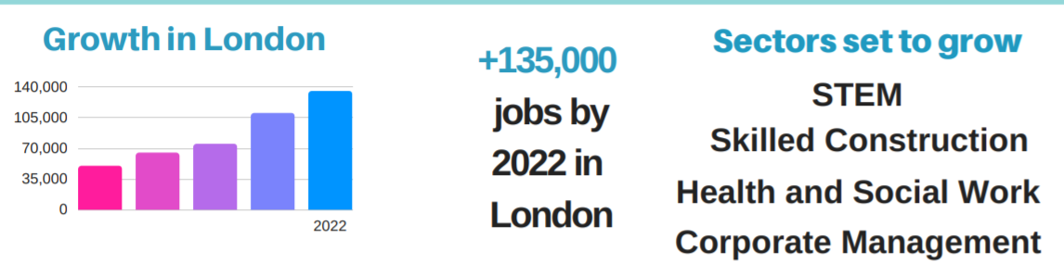
London LMI - The Future

Slide 11
London LMI - the impact on you!
So, how does this help you and what can you do?
Looking Forwards…..Learn.
From other people and from employers, universities and apprenticeship providers about what qualifications and skills you need to be successful in different careers.
Looking Outwards…..Research.
Find out about your possible career pathways and options and see what different opportunities there are for you in your local area, in London, the UK and the whole world!!
Taking Action…..Opportunities.
What are you doing now to prepare for the future? Learn new skills, undertake visits, try new things, challenge yourself. How can you stand out? It's never too early to start thinking about your future!

Slide 12
Looking forwards; Looking outwards; Taking action.

